Slide 1
How to use MultiblockJS
117458866249

Slide 2
Before we start we should download these mods:
Rhino
I know this wiki is really bad , but I can’t give you better one sorry
KubeJS
MultiblockJS
(This can make you code faster)
ProbeJS

Slide 3
Part 01
Register blocks

Slide 4
Now register a multiblock controller
If you want to modify its rendershape ( like geckolib )
Register like this

Slide 5
Then create its appearance
Put your model file here
When the multiblock doesn’t form
The controller will use this model
xxx.json
When it forms
The controller will use this model
xxx_formed.json
When the multiblock in working
The controller will use this model
xxx_working.json
(This mod will automatically generate several files under “blockstates” , don’t delete them dude)

Slide 6
After that , let’s register ports
Item port
You must write “.setSize(int)” to definition its size
For one example , chest’s size is 27
Large chest’s is 54
Fluid port
“.setSize(2000)” means it can fit 2000 mb fluid

Slide 7
Part 02
Multiblock Definition

Slide 8

Write a MultiblockJS Definition event in server script
Structure name
Controller block ID

Slide 9
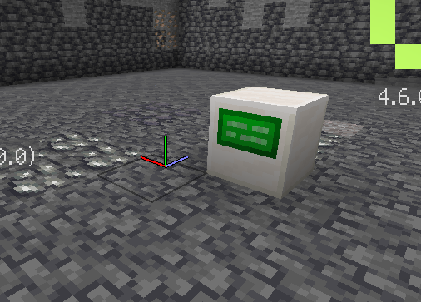
Place controller at (0,0,0)
And make it facing north
Press F3+I and see its facing

Slide 10
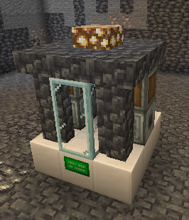
Build multiblock structure around it

Slide 11
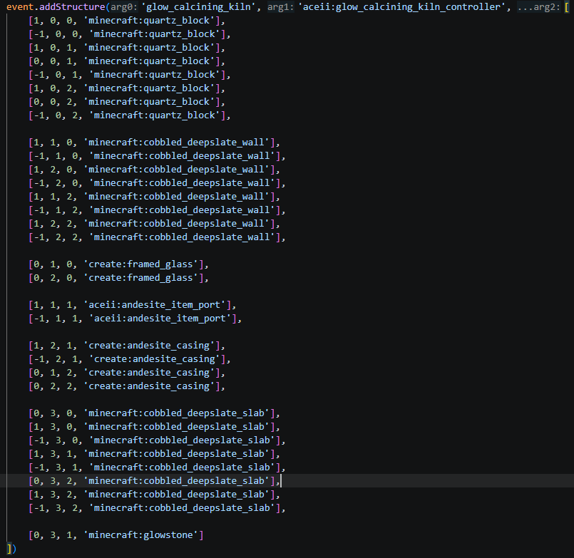
Record each part blocks’ blockpos in world and record them like this
Tip: don’t record the controller’s pos

Slide 12
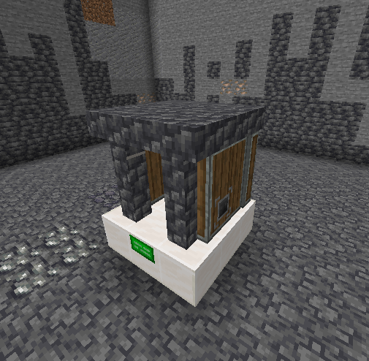
Exit the save file, and then enter the save file again
Shift & rightclick the controller block
The multiblock is available!

Slide 13
Tip:
After you form your multiblock , all of its part will be invisible
If you don’t want to make someblock invisible , register that block like this:

Slide 14
Part 03
Recipe

Slide 15
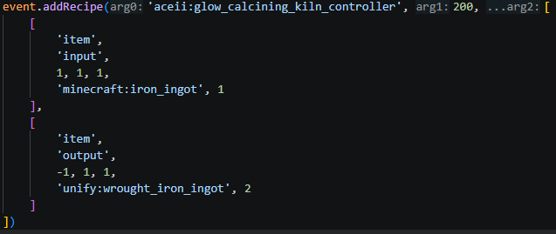
Write event
Add recipe like this

Slide 16
The third parameter is the requirement for the machine
Write it like this
[
[
‘item’,
‘input’
0,1,0,
‘modid:example_item’,2
],
[
‘item’,
‘output’
2,3,0,
‘modid:example_item_2’,1
]
other requirements…
]

Slide 17
Part 04
Requirements

Slide 18
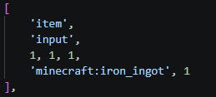
This is a requirement and it can be used in recipe:
I’ll show you all available requirement
If you want to support some mods’ requirement , open a issue pls

Slide 19
Item reqiurement
Type
Input/Output
Port pos(Just like when you define your multiblock)
Item ID
Item count

Slide 20
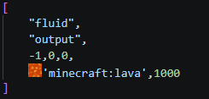
Fluid requirement
Type
Input/Output
Port pos
Fluid ID
Fluid amount(mb)

Slide 21
Part 05
Others

Slide 22
We are going to make FE , Create su , Mekanism Chemical substances requirements available

Slide 23
Have a nice dev
Goodbye!

